Slide 1
Initial Assignment- Transaction analysis
Logical Fit Round

Slide 2
Data Loading and Feature extractions
First load the database using given .sql scripy.
Database contains only one table called transactions.
Transactions table contains ‘transaction_timestamp’ column which is not of date_time format.
First step here is to convert data type of this column to datetime using sql function called ‘str_to_date()’.
Next extract needed features like ‘month’ and ‘month_name’ using sql functions ‘month(date_colum)’ and ‘monthname(date_column)’ respectively.

Slide 3
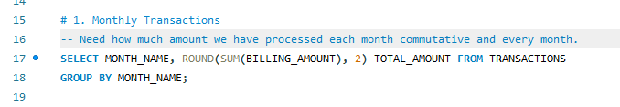
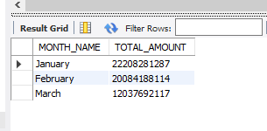
1. Monthly Transactions - Need how much amount we have processed each month commutative and every month.
SQL Query & Output
Result Explanation
Total Revenue or amount generated through transaction in month of ‘January’ is high as compare to other two months.
January has highest amount collection followed by February and March.

Slide 4
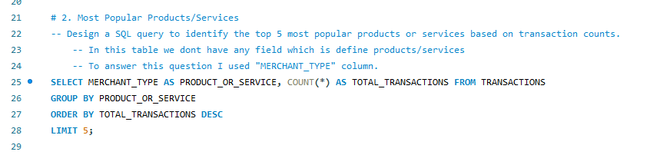
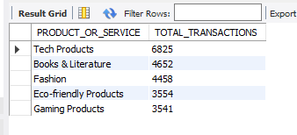
2. Most Popular Products/Services - Design a SQL query to identify the top 5 most popular products or services based on transaction counts.
SQL Query & Output
Result Explanation
“Tech Products” category has highest transaction made over the period of time.
“Tech Products”, “Books & Literature”, “Fashion”, “Eco-friendly Products” and “Gaming Products” are the top 5 product category with high number of transactions.

Slide 5
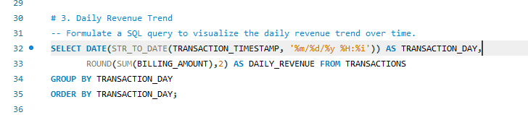
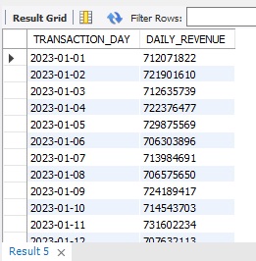
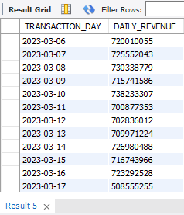
3. Daily Revenue Trend - Formulate a SQL query to visualize the daily revenue trend over time.
SQL Query & Output
Result Explanation
Transactions table contains transaction details from 1 January 2023 to 17 March 2023.
Transactions done every day from 1st January to 17th March, No date inconsistency.
Every day the Revenue crossed 700 Million business.
Last day of Transaction record i.e. 17th March has revenue 508 Millions.
There is No Trend in “Revenue”.

Slide 6
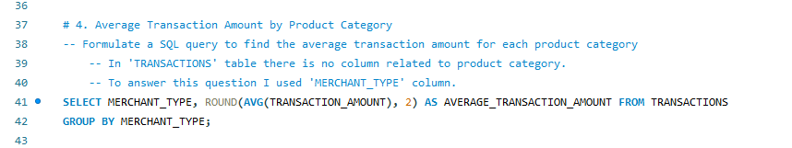
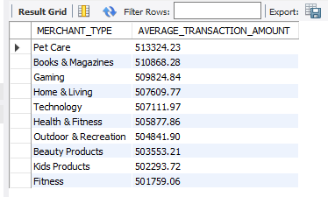
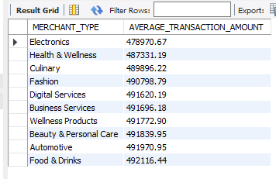
4. Average Transaction Amount by Product Category - Formulate a SQL query to find the average transaction amount for each product category
SQL Query & Output
Result Explanation
There are total 42 different merchant types.
“Pet Care” merchant type has highest average transaction amount.
“Electronica” merchant type has lowest average transaction amount.

Slide 7
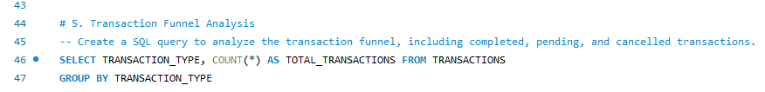
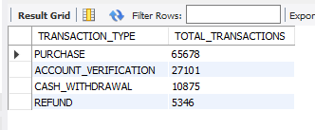
5. Transaction Funnel Analysis - Create a SQL query to analyze the transaction funnel, including completed, pending, and cancelled transactions.
SQL Query & Output
Result Explanation
There are total 4 different types of transactions, “Purchase”, “Account_Verification”, “Cash_Withdrawal” and “Refund”.
Most transactions are of “Purchase” type.
Least transactions are of “Refund” type.

Slide 8
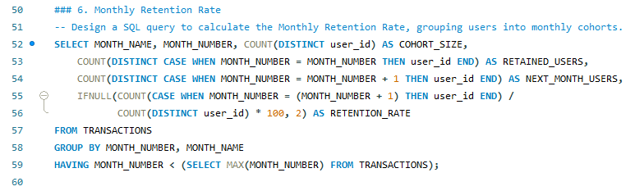

6. Monthly Retention Rate - Design a SQL query to calculate the Monthly Retention Rate, grouping users into monthly cohorts.
SQL Query & Output
Result Explanation
Transactions table contains transactions for 3 months only.
More unique customers are did their transactions in January, followed by February.

Slide 9
Thank you
By- Suraj Honkamble

